Slide 1
Object Database
Dr.U.K.Sridevi
Department of Applied Mathematics and Computational Sciences

Slide 2
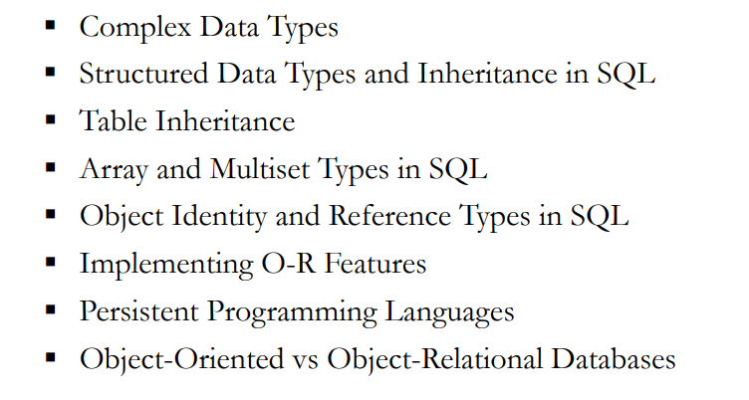
Object-Based Databases

Slide 3
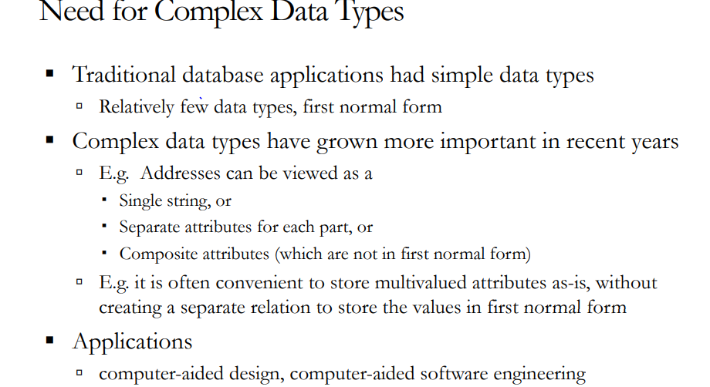

Slide 4
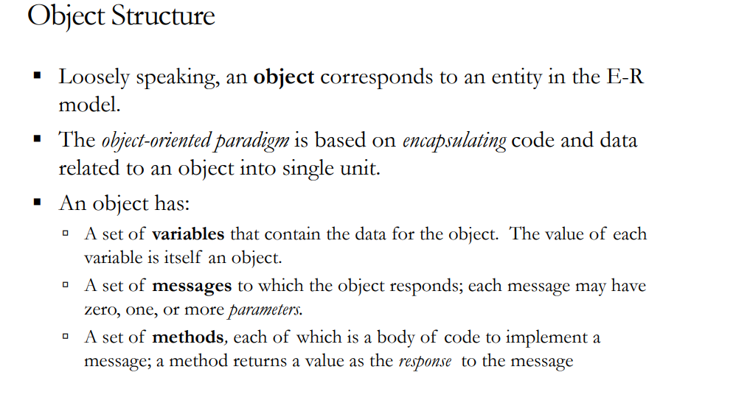

Slide 5
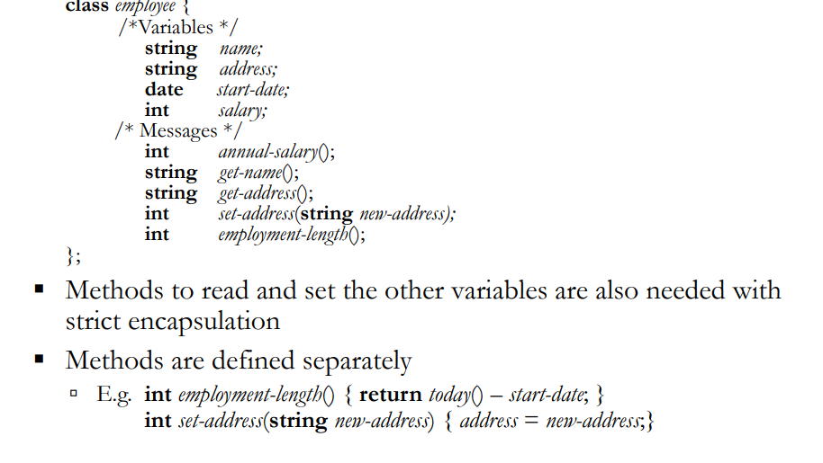

Slide 6
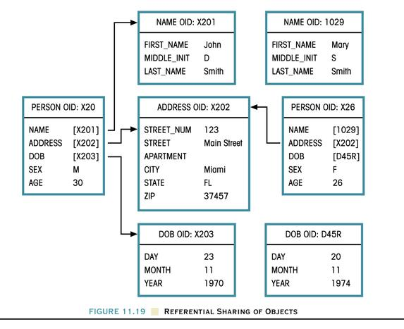
Sharing Objects

Slide 7
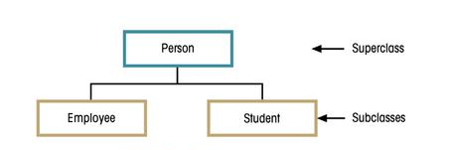
Object Schemas: The Graphical Representation of Objects
Class-Subclass Relationships
Notes:
57

Slide 8
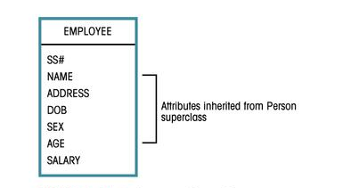
Employee Object Representation
Notes:
58

Slide 9
Object Schemas: The Graphical Representation of Objects
Interobject Relationships: Attribute-Class Link
A attribute-class or interobject relationship is created when an object’s attribute references another object of the same or different class.
Relationship Representation:
Representing 1:M Relationships
Representing M:N Relationships
Representing M:N Relationships with an Intersection Class
Notes:
59

Slide 10
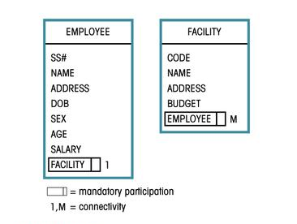
Representing The 1:M Relationship
Notes:
62

Slide 11
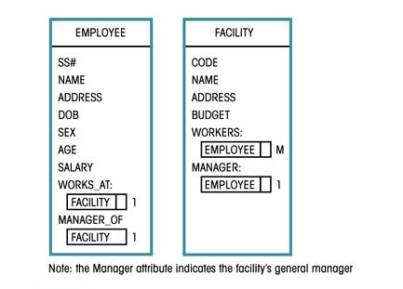
Representing The 1:1 And 1:M Relationships
Notes:
62

Slide 12
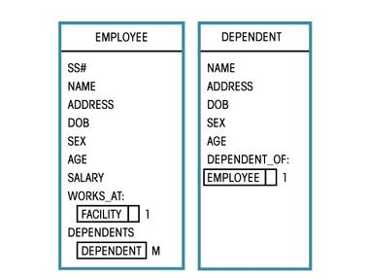
Employee-Dependent Relationship
Notes:
62

Slide 13
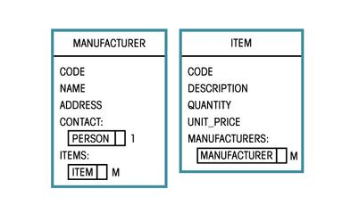
Object Schemas: The Graphical Representation of Objects
Representing M:N Relationships

Slide 14
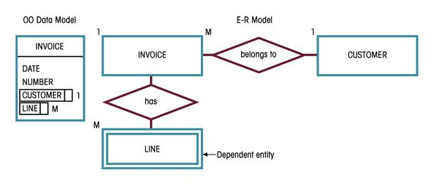
An Invoice Representation
Notes:
76

Slide 15
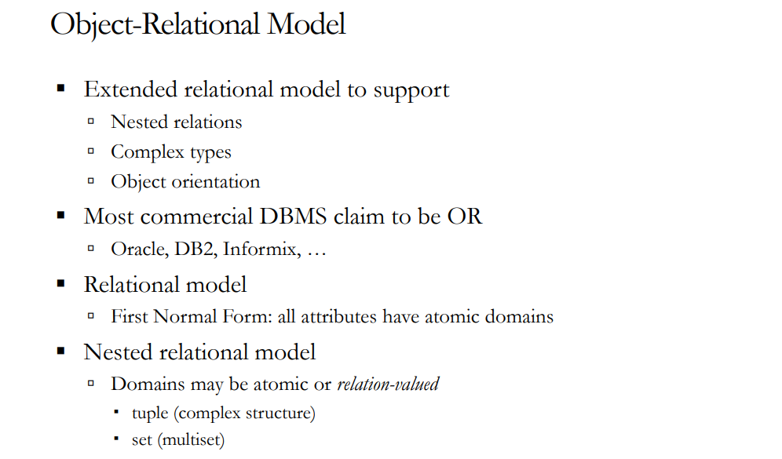

Slide 16
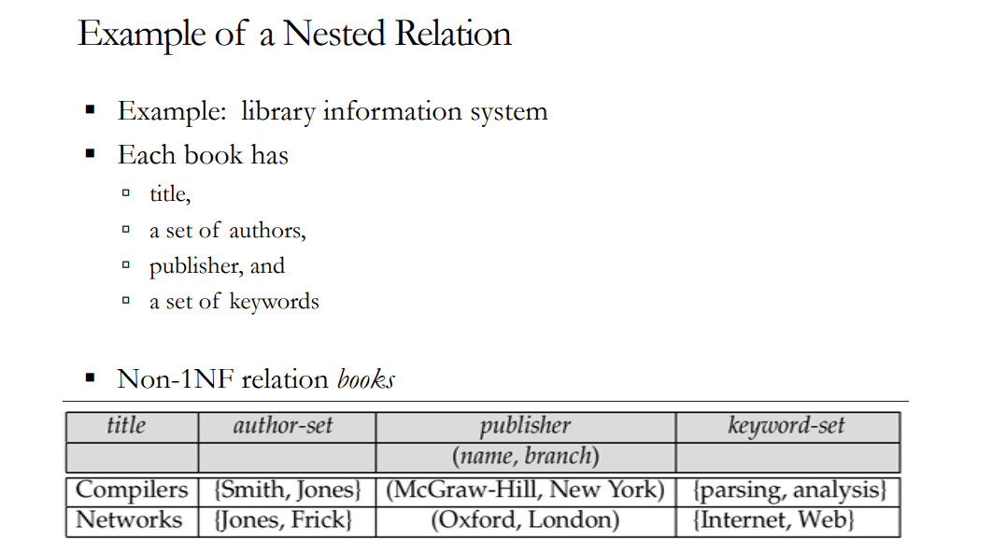

Slide 17
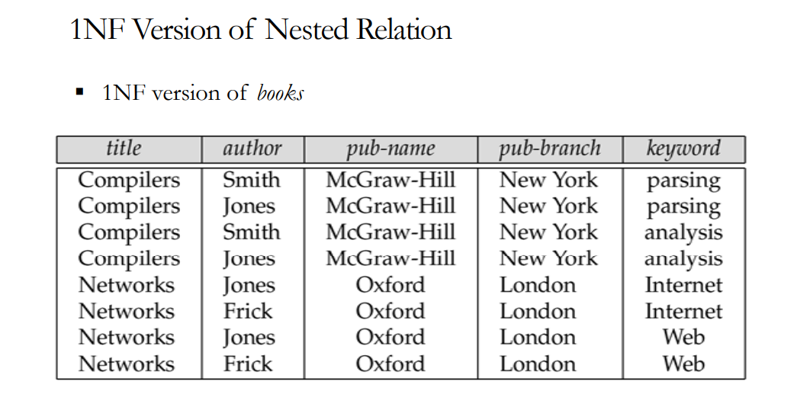

Slide 18
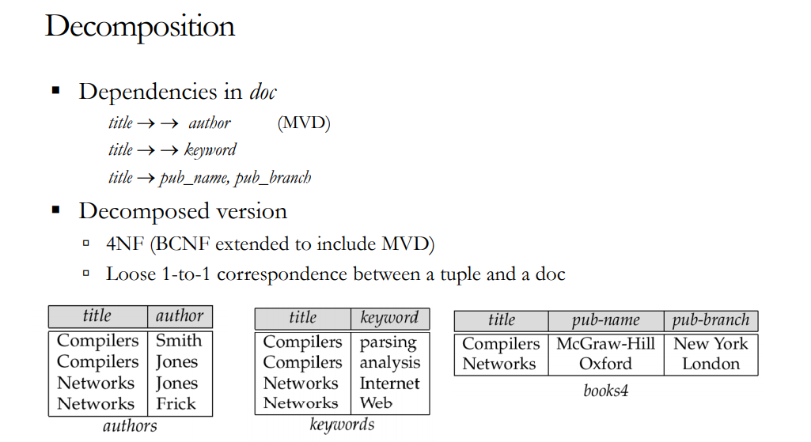

Slide 19
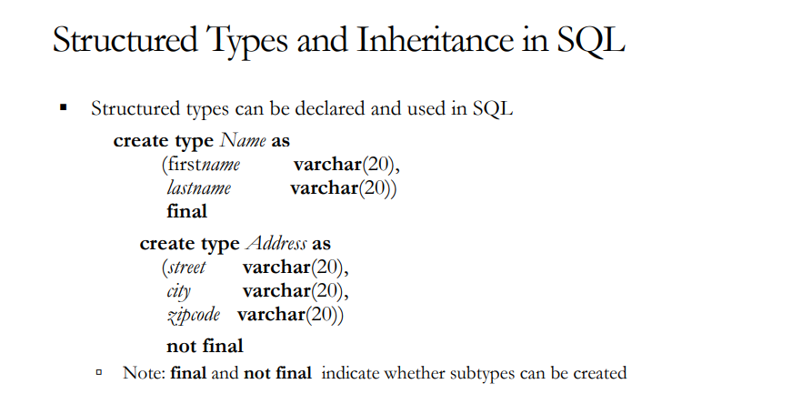
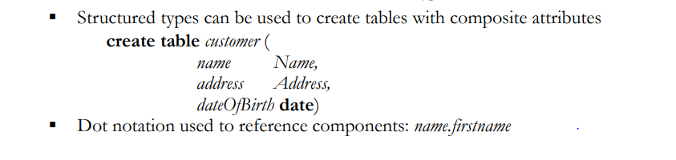

Slide 20
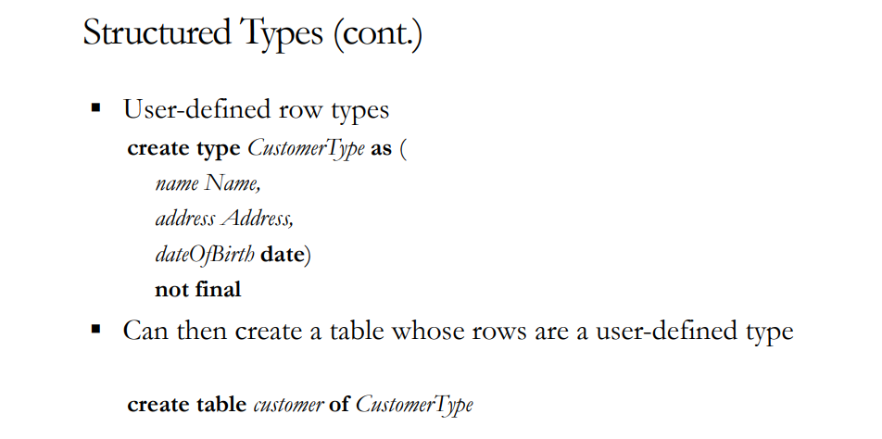

Slide 21
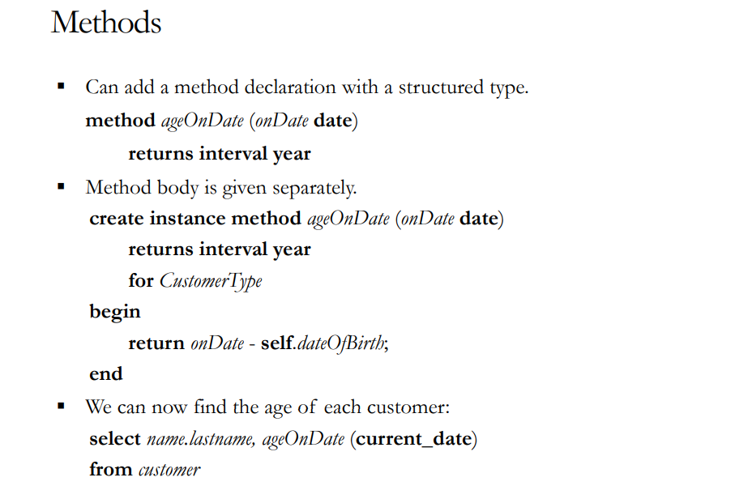

Slide 22
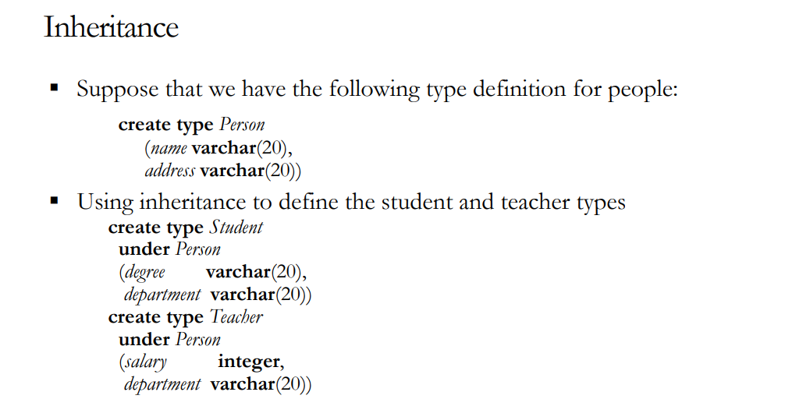

Slide 23
OODBMS: Advantages and Disadvantages
Advantages
More semantic information.
Support for complex objects.
Extensibility of data types.
Improved performance with efficient caching.
Versioning.
Faster development and easy maintenance through inheritance and reusability.
Technology-driven product for next generation DBMS.
Potential to integrate DBMSs into a single environment.
Disadvantages
Strong opposition from the established players.
Lack of theoretical foundation.
Retrogressive to the old pointer systems.
Lack of standard ad hoc query language.
Lack of business data design and management tools.
Steep learning curve.
Lack of resources.
Notes:
84

